Slide 1
Final project: Introduction to cloud computing project
Team Members Wolf: Adam kayal
Itay Mohabati
Shai Yosef Ofir Uziel
Emanuel Davidov
Yossi Shemtov

Slide 2
Introduction
The main purpose of this code is to provide users with an interactive application that facilitates project management and data analysis.
Key Features
JSON Data Upload and Display
Interactive Chatbot
Parameter Selection and Filtering
Data Processing and Categorization
Displaying Filtered Data
Flexible Navigation
Visualizing Interesting Statistics

Slide 3
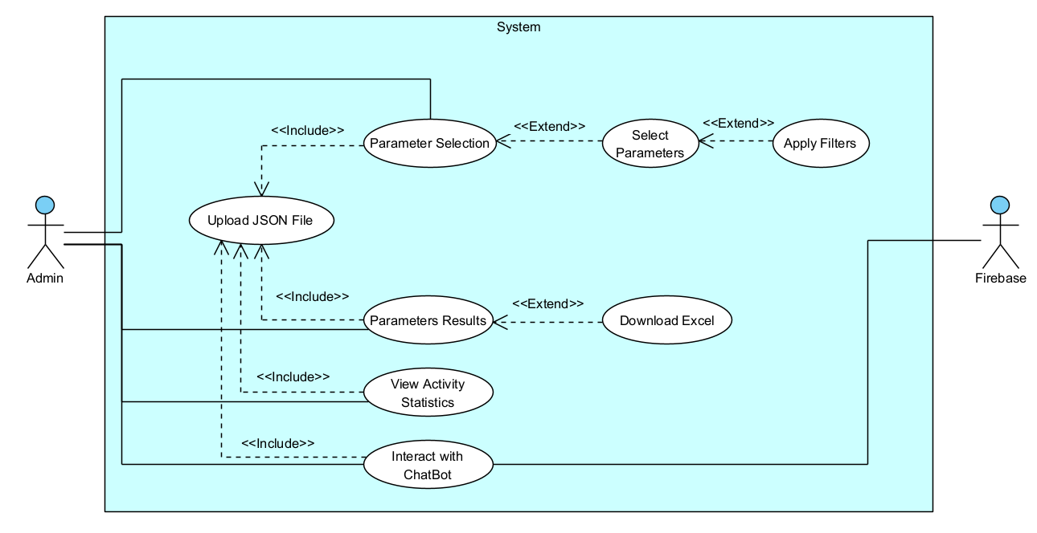
Use case

Slide 4
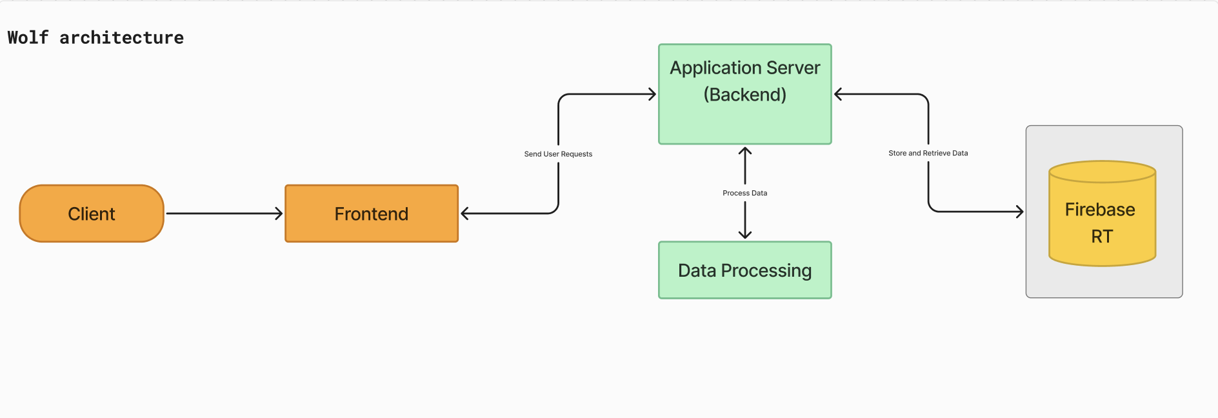
System Architecture

Slide 5
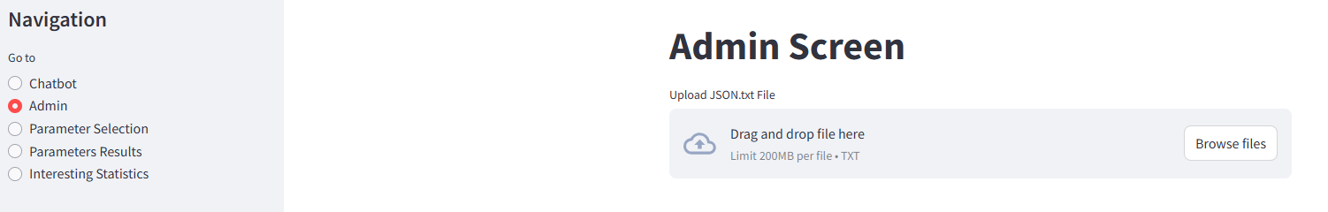
Admin Screen
Upload a JSON file containing activity data.
The JSON data is loaded and stored in session state for further processing.

Slide 6
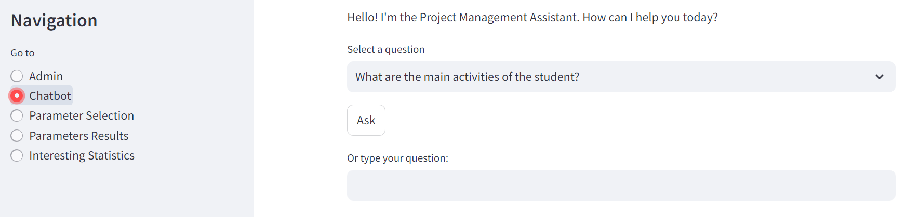
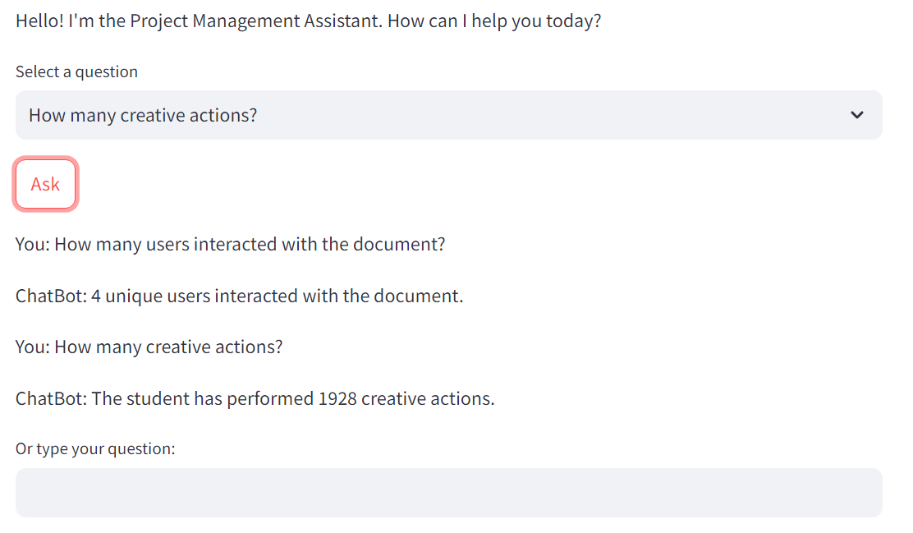
ChatBot
Interact with the chatbot to get insights about activities.
Ask questions about the main activities, and the chatbot responds with relevant information based on predefined patterns and reflections.

Slide 7
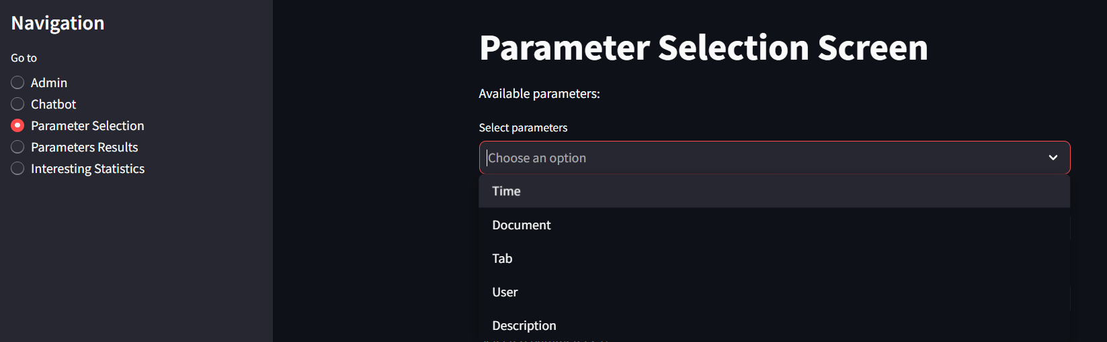
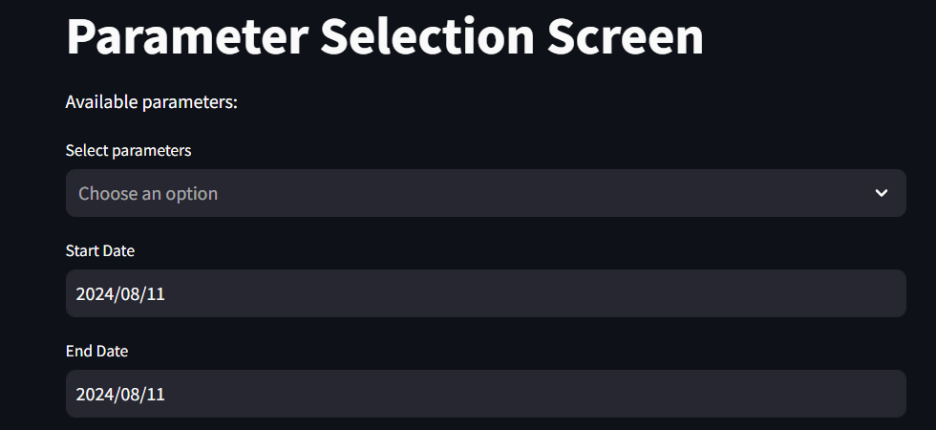
Parameter Selection Screen
Select specific parameters from the uploaded data.
Apply filters to refine the data based on selected parameters.

Slide 8
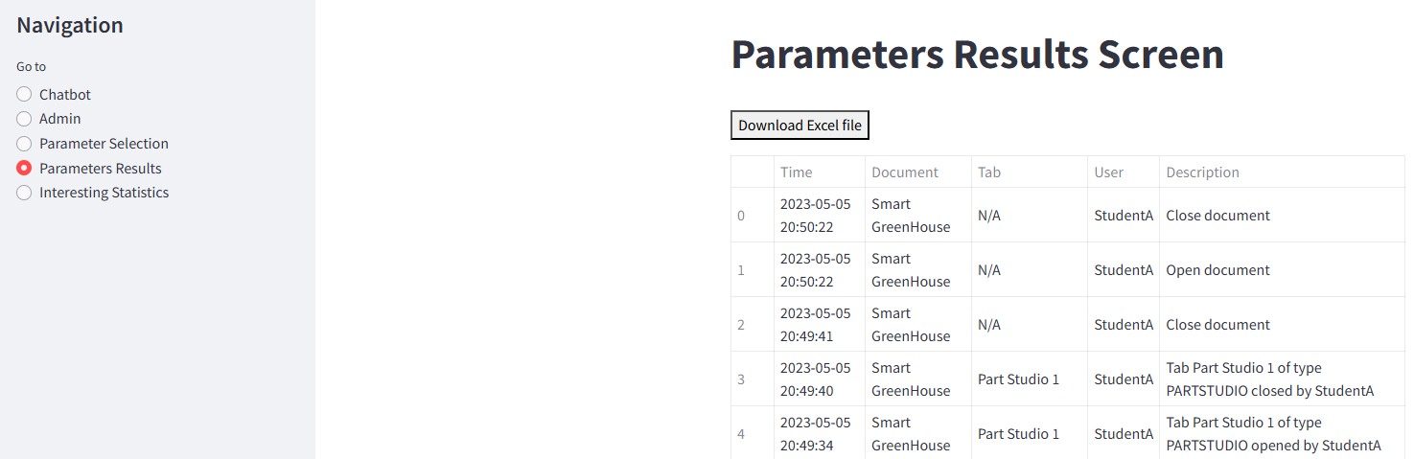
Parameter Results
View the filtered data in a tabular format.
Option to download the filtered data as an Excel file.

Slide 9
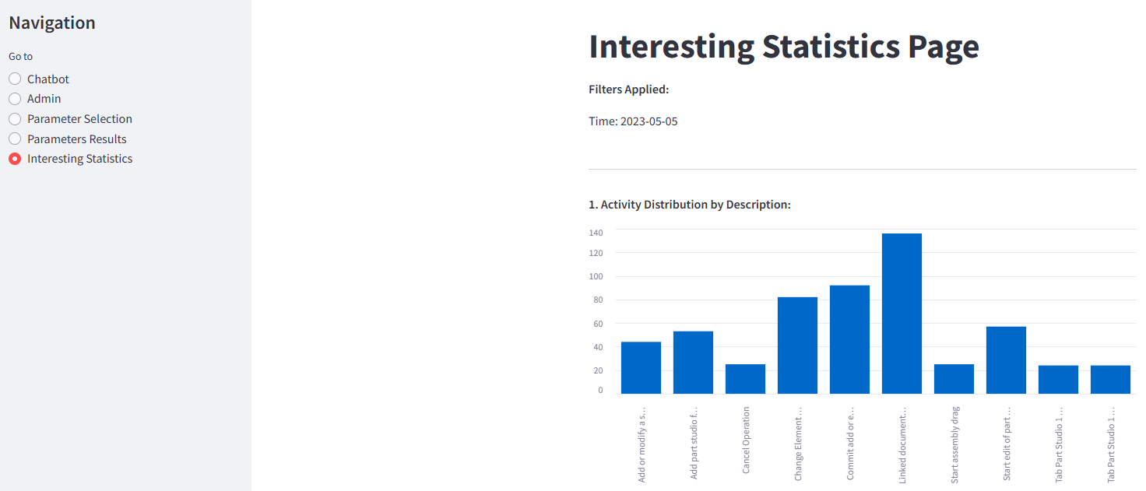
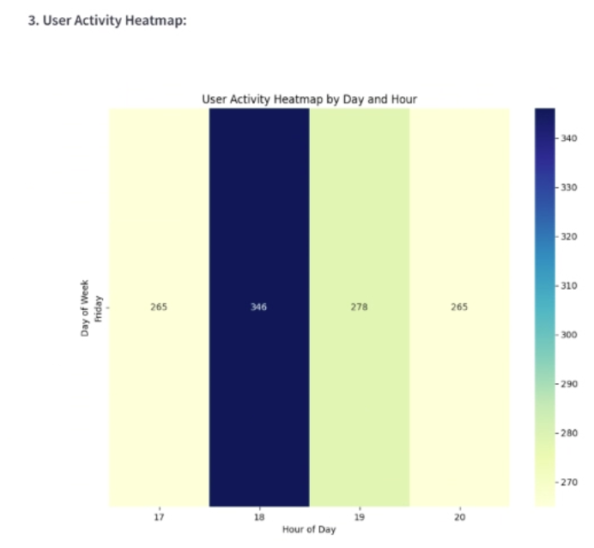
Interesting Statistics
View various statistics and visualizations based on the filtered data.
Includes activity distribution, document interaction patterns, user activity heatmap, and top documents and users.

Slide 10
Peer review
Peer Feedback Received
Filtering by data: It was noted that the application did not allow users to filter data by a date range.
Data parameter: The feedback suggested that instead of requiring users to input all data manually, a template should be provided.
Maintaining Filters When returning from results to the selection screen, the filters were reset.
Actions Take
Implemented Date Range Filtering: Users can now filter data by selecting a specific date range.
Introduced Data Entry Templates: Provided users with a template for data entry to streamline the process
Persistent Filters: The system remained the same because in our opinion if the user returns to parameter selection screen he wants to perform a new filter and therefore a reset is performed.

